Slide 1

Exploratory Data Analysis
Average Transaction Amount each month: AUD 75,4428.
Average Transaction amount per customer each month is AUD 7,544.
The highest amount of spending was made in the span of a week was AUD 178384.66 and it was made between 8/1/2018-8/7/2018.
ANZ
By Savyata Regmi

Slide 2
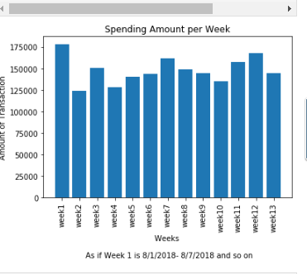
Spending Over Week
I set 8/1/2018 – 8/7/2018 as week1, 8/8/2018 – 8/14/2018 as week2 and so on, and hence we have total 13 weeks in 3 months.
As shown in bar diagram, the highest amount of purchases were made on week1, i.e., between 8/1/2018 - 8/7/2018 which is approximately AUD 175,000 and the lowest amount of purchases were made on week 2 and week 3 which is approximately AUD 125,000.

Slide 3
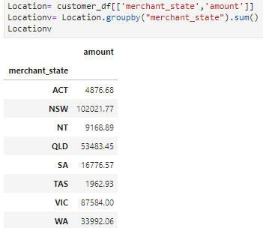
Spending by State
New South Wales has the big spender customers and Victoria has the second big spender customers. The least spending state is Tasmania.

